Slide 1

Introduction to Software Engineering (ISE102) Tutorial Week 3

Slide 2
Week 3 Outline
Object-Oriented Programming (OOP)
Hands-On Activity 1 (CBA_BankAccount_Deposit)
Hands-On Activity 1 (CBA_BankAccount_Deposit in Java)
Hands-On Activity 2 (OOP Example – Train Class)
Hands-On Activity 3 (Create Your Favourite Aussie Sport Class)
Hands-On Activity 4 (Create Multiple Objects and Call Their Methods)
Data Types, Variables, and Operators
Hands-On Activity 5: Data Types, Variables, and Operators
Strings & String Formatting
Arrays
Java Arrays in Eclipse — StationsApp Demo
Array Example in Java (Visual Studio Code)- Necessary Package in Visual Studio Code
Input/Output (I/O)
Input/Output (I/O) – Java Example in Eclipse

Slide 3
Object-Oriented Programming (OOP)
OOP is like building with LEGO:
Each LEGO piece = Object (it has shape, colour, purpose)
LEGO instructions = Class (blueprint to create objects)

Slide 4
Object-Oriented Programming (OOP)
Key OOP ideas:
Class – blueprint (e.g., “Car” design)
Object – actual item made from the blueprint (e.g., a Toyota Corolla in Sydney)
Attributes – properties (e.g., colour, model)
Methods – actions (e.g., start engine, honk)

Slide 5
Object-Oriented Programming (OOP)
Australian Example:
Class: Kangaroo
Objects: Red Kangaroo, Eastern Grey Kangaroo in NSW
Attributes: tailLength, weight
Methods: hop(), eatGrass()

Slide 6
Object-Oriented Programming (OOP)
OOP Concept | Real-world Analogy | Australian Example
Class | Building design | "Opal Tower" plan in Sydney
Object | Actual building | Completed Opal Tower
Attributes | Room size, colour | Apartment floor plan
Methods | Actions | Lift moves, lights turn on

Slide 7
Object-Oriented Programming (OOP)
Research Discussion Question: Why do modern apps in Australia (e.g., MyGov, Service NSW) use OOP rather than procedural programming?
Because OOP allows reusable code, easy maintenance, and modelling of real-world services like forms, accounts, and processes.

Slide 8
Object-Oriented Programming (OOP)
Research Discussion Question: Why does Commonwealth Bank’s NetBank use OOP principles instead of procedural programming for its online banking platform?
OOP lets developers create reusable classes like Account, Transaction, and Customer, so features such as viewing statements or transferring money can be reused across mobile and web apps. It also makes it easier to maintain security, adapt to new regulations (like ASIC compliance), and roll out new services such as PayID without rewriting large parts of the system.

Slide 9
Object-Oriented Programming (OOP)
Australian Real-World Analogy Think of NetBank as a shopping centre:
Classes = store blueprints (e.g., Woolworths, JB Hi-Fi)
Objects = actual store branches in the centre
Updating one blueprint updates all branches — just like updating one class in OOP updates all relevant objects in the system.

Slide 10
Hands-On Activity 1 (CBA_BankAccount_Deposit)
Write a class BankAccount in Java or Python with:
Two attributes: account_holder and balance
One method: deposit(amount) that increases the balance and prints the new balance

Slide 11
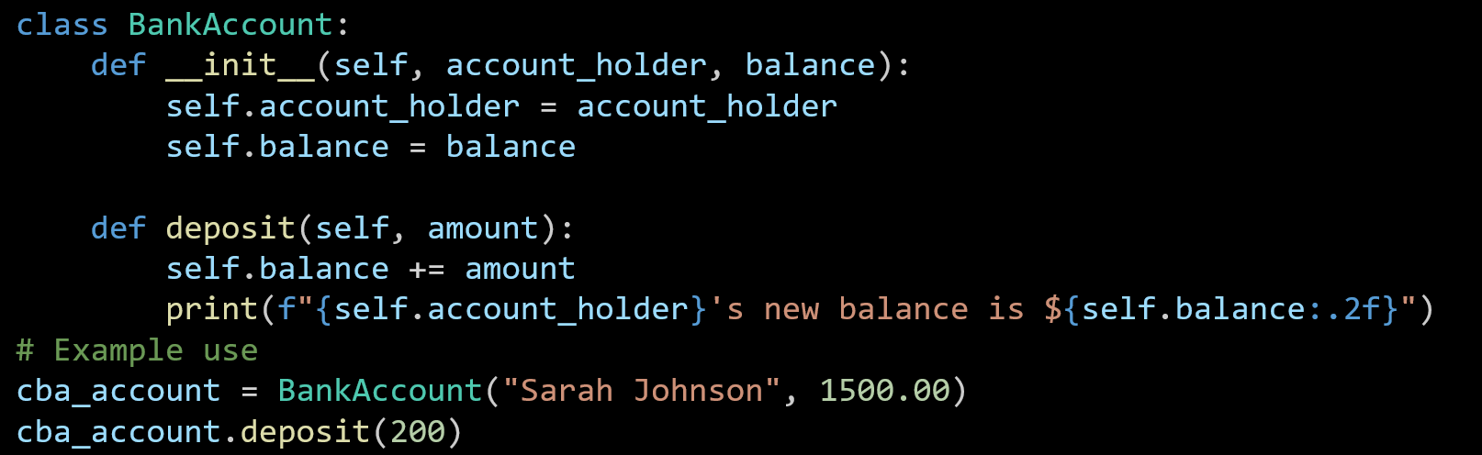
Hands-On Activity 1 (CBA_BankAccount_Deposit in Python)
The BankAccount class is created with two attributes: the account holder’s name and their balance.
The deposit method adds money to the balance and shows the updated amount.
An example account for Sarah Johnson is created, and $200 is deposited to update her balance.

Slide 12
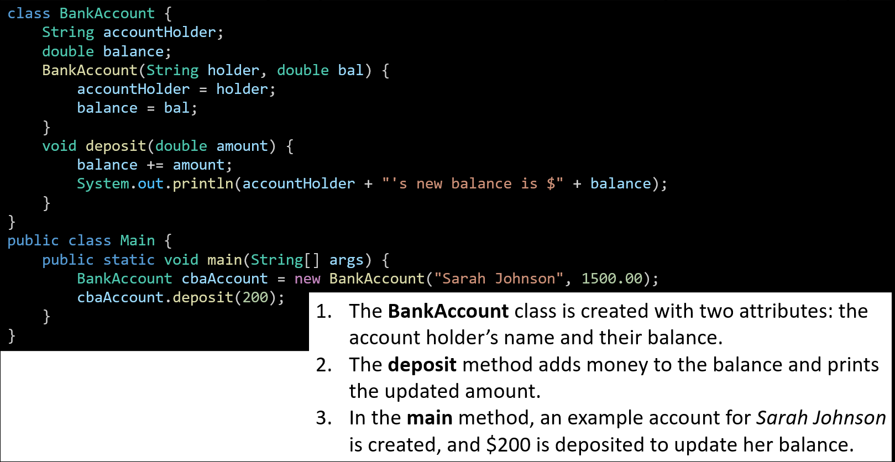
Hands-On Activity 1 (CBA_BankAccount_Deposit in Java)
The BankAccount class is created with two attributes: the account holder’s name and their balance.
The deposit method adds money to the balance and prints the updated amount.
In the main method, an example account for Sarah Johnson is created, and $200 is deposited to update her balance.

Slide 13
Hands-On Activity 2 (OOP Example – Train Class)
Build a class Train that can show the train number and destination (e.g., Sydney → Newcastle). Use Python or Java.

Slide 14
Hands-On Activity 3 (Create Your Favourite Aussie Sport Class)
Create a class for a favourite Aussie sport (e.g., CricketPlayer) with attributes and actions.

Slide 15
Hands-On Activity 4 (Create Multiple Objects and Call Their Methods)
Write code to create two different objects from the same class and call their methods.

Slide 16
Data Types, Variables, and Operators
Variables are like containers that store information.
Python: Flexible – you can put anything inside.
Java: Strict – each container has a label for the type it can hold.

Slide 17
Data Types, Variables, and Operators
These types are explicitly defined in Java, but Python handles them differently:
Java: We must declare the type (int age = 25;) – it’s strictly typed.
Python: We don’t declare the type (age = 25) – it’s dynamically typed, but those kinds of values still exist.
Common types:
int – whole numbers
float / double – decimals
boolean – true/false
char – one letter
String – text

Slide 18
Data Types, Variables, and Operators
So:
In Java, int, double, boolean, char, and String are actual type keywords (except String, which is a class).
In Python, the variable type is inferred automatically, but it still stores integers, floats, booleans, strings, etc. (char isn’t a separate type; it’s just a string of length 1).
Common types:
int – whole numbers
float / double – decimals
boolean – true/false
char – one letter
String – text

Slide 19
Data Types, Variables, and Operators
Australian Example:
Temperature in Sydney: float
Number of trams in Melbourne: int
Is it a public holiday in NSW? boolean
Type | Python Example | Java Example
int | age = 25 | int age = 25;
float/double | price = 4.5 | double price = 4.5;
boolean | sunny = True | boolean sunny = true;

Slide 20
Data Types, Variables, and Operators
Research Discussion Question: Why is it important to choose the correct data type for Australian weather data?
Correct types ensure accurate storage and calculations, e.g., temperature needs decimals for precision

Slide 21
Hands-On Activity 5: Data Types, Variables, and Operators
Declare and print three variables for your suburb’s name, current temperature, and if it’s raining. (in python or java)

Slide 22
Hands-On Activity 5: Data Types, Variables, and Operators
Python
suburb = "Castle Hill"
temperature = 22.5
is_raining = False
print(suburb, temperature, is_raining)

Slide 23
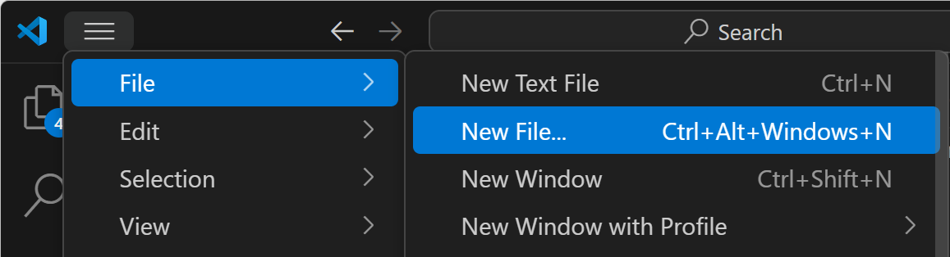
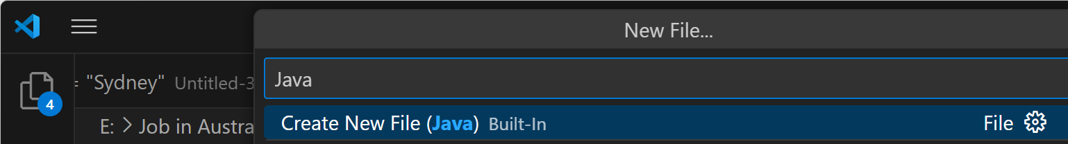
Hands-On Activity 5: Data Types, Variables, and Operators
Java
In Java, all code that runs must be inside a method, usually the main method, and inside a class.

Slide 24
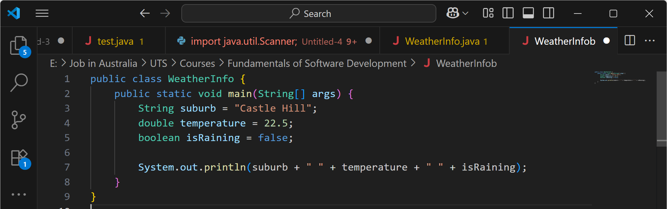
Hands-On Activity 5: Data Types, Variables, and Operators
This Java program stores a suburb name, its temperature, and whether it’s raining, then prints them all together on one line. It’s a simple Java example showing variables of different data types and basic output.

Slide 25
Strings & String Formatting
String = text data.
Formatting = inserting variables into text.
Think of it like a fill-in-the-blank postcard.
Australian Example:
"Welcome to {}!" → "Welcome to Sydney!"

Slide 26
Strings & String Formatting
Python Example:
city = "Sydney"
print(f"Welcome to {city}!")

Slide 27
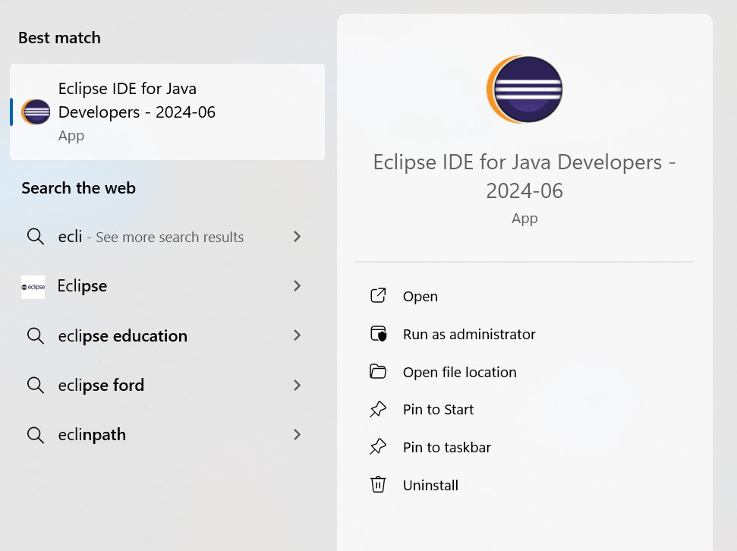
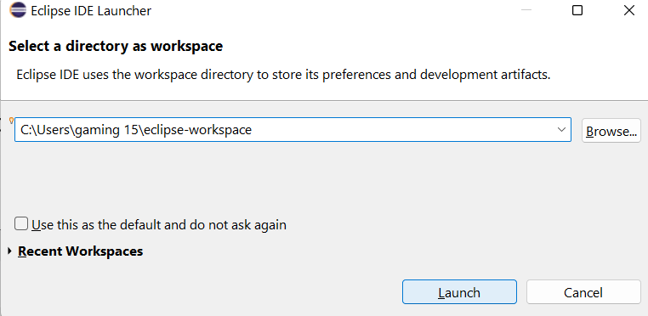
Strings & String Formatting
Java Example in Eclipse:

Slide 28
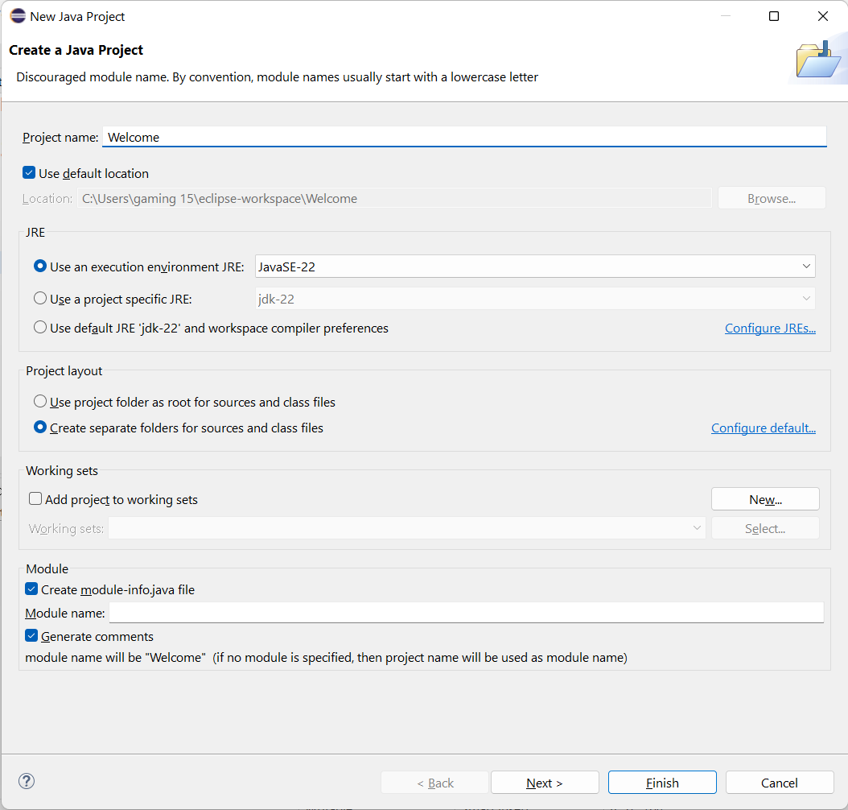
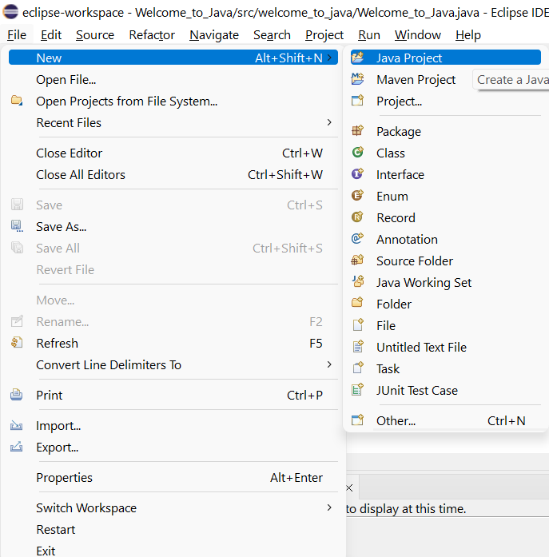
Strings & String Formatting
New Java Project in Eclpise

Slide 29
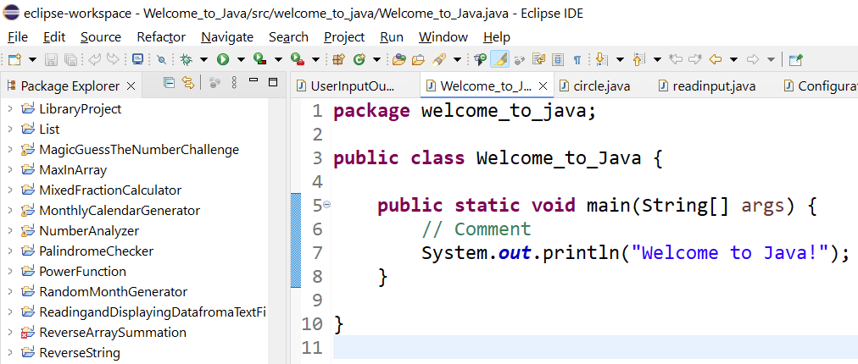
Java Code
package welcome_to_java; – Groups this class into a package called welcome_to_java.
public class Welcome_to_Java { ... } – Defines a public class named Welcome_to_Java.
public static void main(String[] args) – The entry point where the program starts running.

Slide 30
Java Code
// Comment – A note for humans, ignored by the computer.
System.out.println("Welcome to Java!"); – Prints the message Welcome to Java! on the screen.

Slide 31
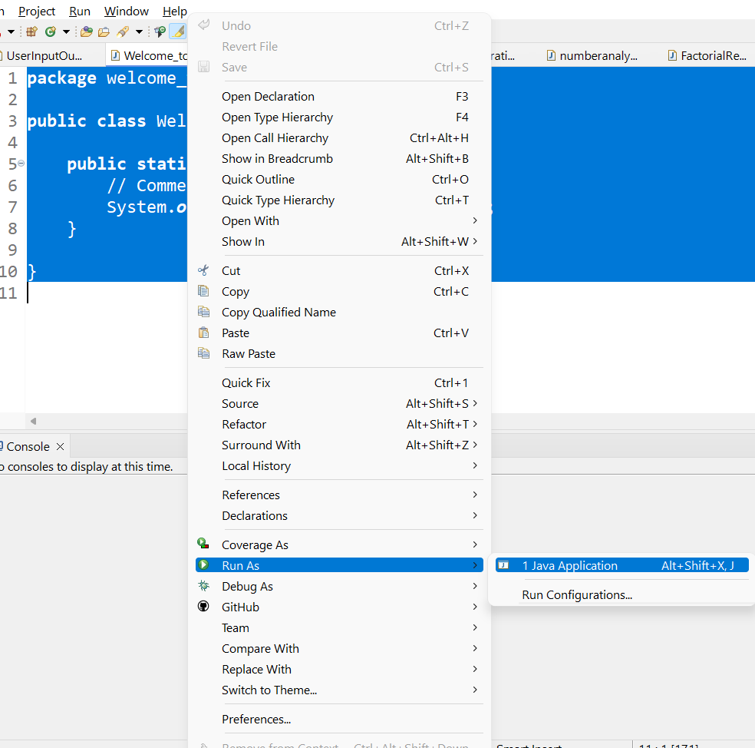
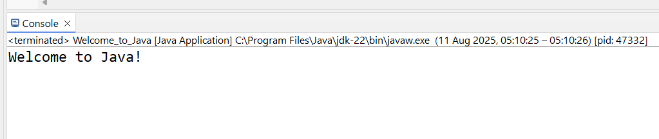
Strings & String Formatting
Run as Java Application (Eclipse)

Slide 32
Arrays
Array = a train carriage with fixed seats for values of the same type.
In Python: list (more flexible).
In Java: fixed size array.
Australian Example:
Array of Sydney train station names: ["Central", "Redfern", "Strathfield"]

Slide 33
Arrays
Python example:
stations = ["Central", "Redfern", "Strathfield"]
print(stations[0])
Java example:
String[] stations = {"Central", "Redfern", "Strathfield"};
System.out.println(stations[0]);
That code doesn’t work by itself in Java because Java doesn’t allow loose statements — everything must be inside a class and usually inside the main method.

Slide 34
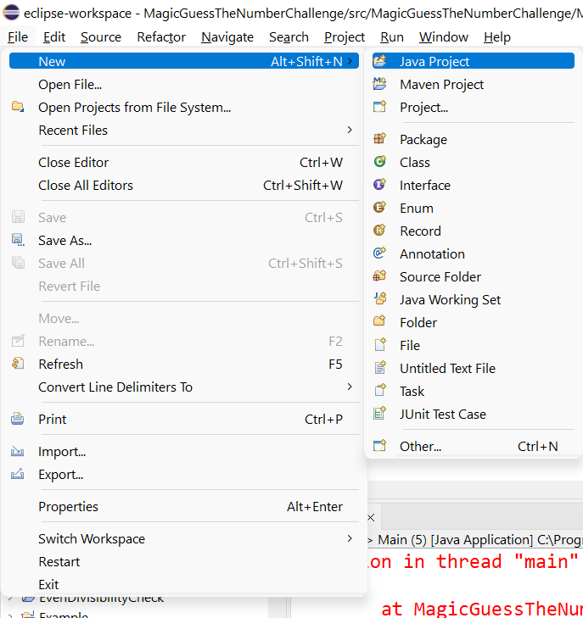
Java Arrays in Eclipse — StationsApp Demo
Create project
File ▸ New ▸ Java Project
Project name: TrainStationsDemo
Uncheck “Create module-info.java” (if shown).
Click Finish.

Slide 35
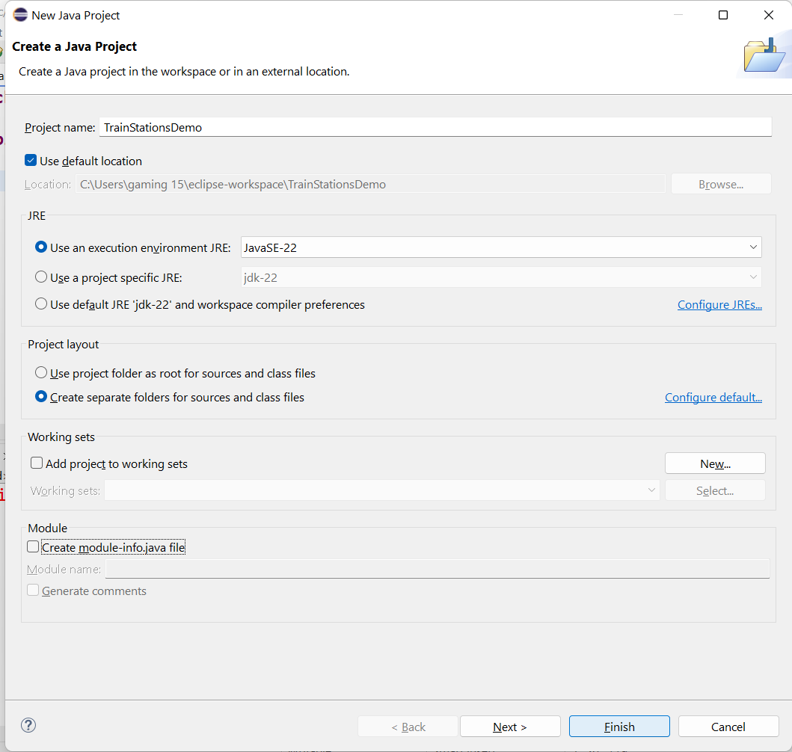
Java Arrays in Eclipse — StationsApp Demo
Create project
File ▸ New ▸ Java Project
Project name: TrainStationsDemo
Uncheck “Create module-info.java” (if shown).
Click Finish.

Slide 36
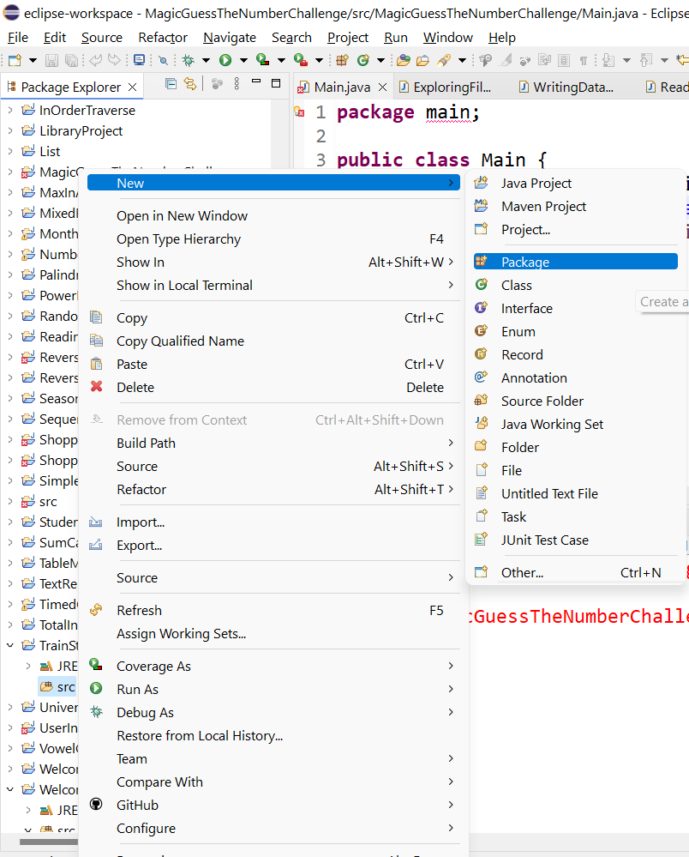
Java Arrays in Eclipse — StationsApp Demo
Make a package
In Package Explorer, right-click src ▸ New ▸ Package
Name: au.sydney.demo ▸ Finish.

Slide 37
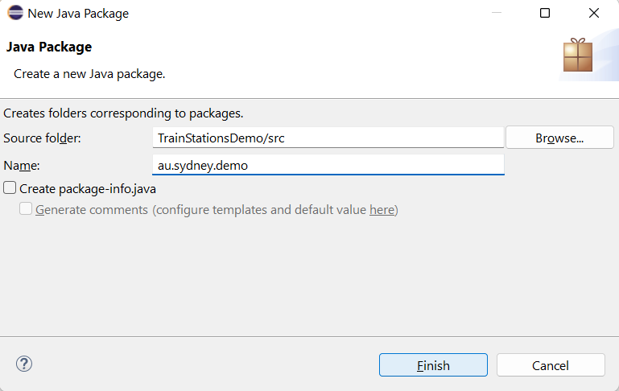
Java Arrays in Eclipse — StationsApp Demo
Make a package
In Package Explorer, right-click src ▸ New ▸ Package
Name: au.sydney.demo ▸ Finish.

Slide 38
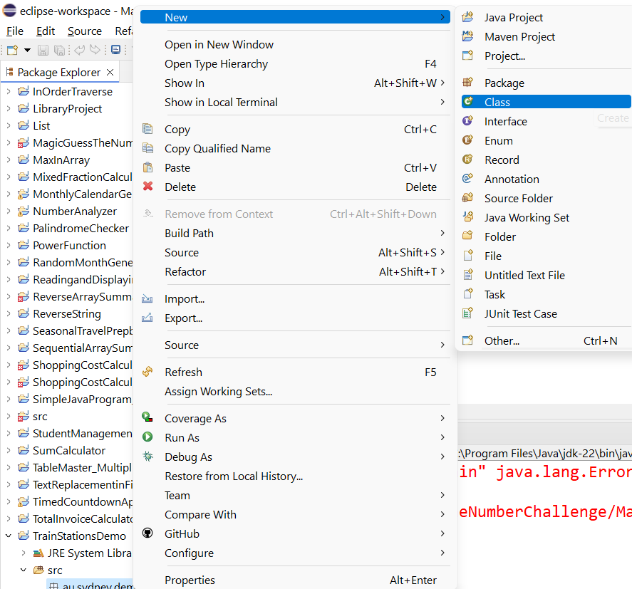
Java Arrays in Eclipse — StationsApp Demo
Add a class with main
Right-click au.sydney.demo ▸ New ▸ Class
Name: StationsApp
Tick public static void main(String[] args) ▸ Finish.

Slide 39
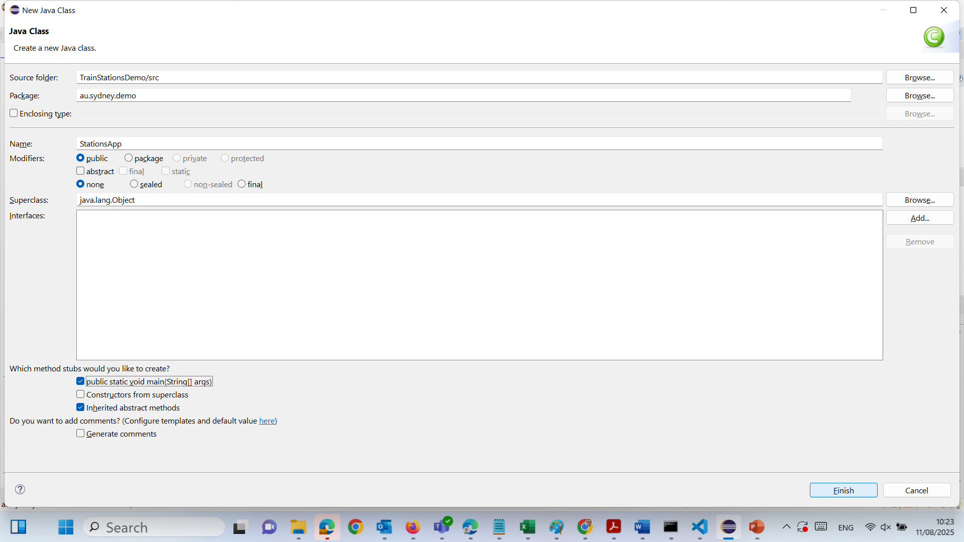
Java Arrays in Eclipse — StationsApp Demo
Add a class with main
Right-click au.sydney.demo ▸ New ▸ Class
Name: StationsApp
Tick public static void main(String[] args) ▸ Finish.

Slide 40
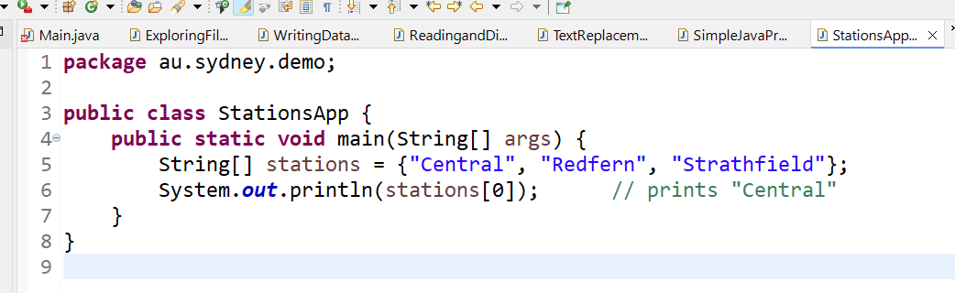
Java Arrays in Eclipse — StationsApp Demo
Add a class with main
Right-click au.sydney.demo ▸ New ▸ Class
Name: StationsApp
Tick public static void main(String[] args) ▸ Finish.

Slide 41
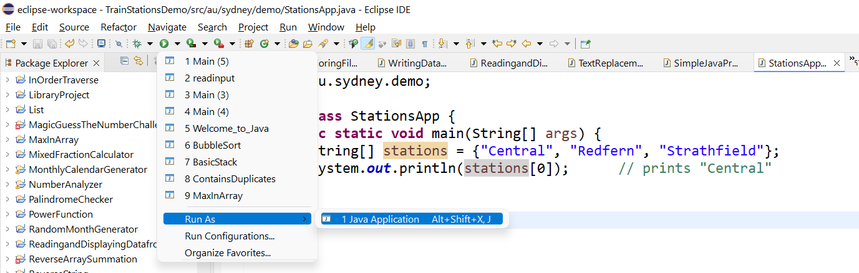
Java Arrays in Eclipse — StationsApp Demo
Run it
Ctrl+S to save → click the green Run button (or Run ▸ Run).
Expected output: Central

Slide 42
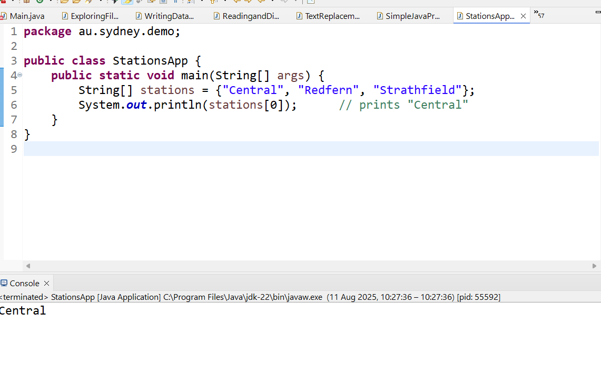
Java Arrays in Eclipse — StationsApp Demo
Run it
Ctrl+S to save → click the green Run button (or Run ▸ Run).
Expected output: Central

Slide 43
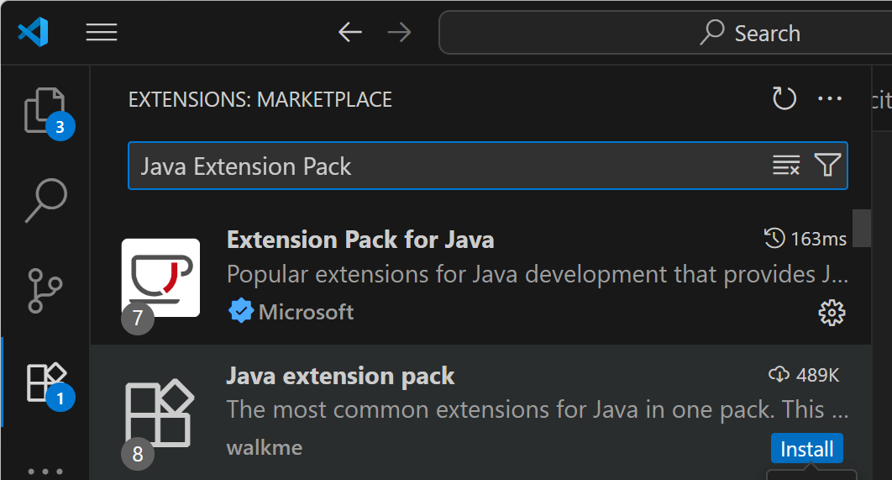
Array Example in Java (Visual Studio Code)- Necessary Package in Visual Studio Code
How to run in Visual Studio Code:
Install the Java Extension Pack from the Extensions Marketplace.
Create a file called Main.java.
Paste the full code above.
Save → click Run Java (or use terminal: javac Main.java then java Main
The first one — Extension Pack for Java by Microsoft.
It’s the official and most complete Java setup for VS Code, and it includes:
Language support (syntax highlighting, IntelliSense)
Debugger for Java
Java Test Runner
Maven and Gradle integration
Project Manager for Java

Slide 44
Input/Output (I/O)
Input = data coming in (keyboard, file)
Output = data going out (screen, file)
Australian Example:
Input: Enter your Opal card balance
Output: Display remaining trips

Slide 45
Input/Output (I/O)
Python Example:
name = input("Enter your name: ")
print(f"Hello, {name}!")

Slide 46
Input/Output (I/O)
Java Example:
import java.util.Scanner;
Scanner sc = new Scanner(System.in);
System.out.print("Enter your name: ");
String name = sc.nextLine();
System.out.println("Hello, " + name + "!");
We need to place this code inside a class with a public static void main(String[] args) method to run it in Java.

Slide 47
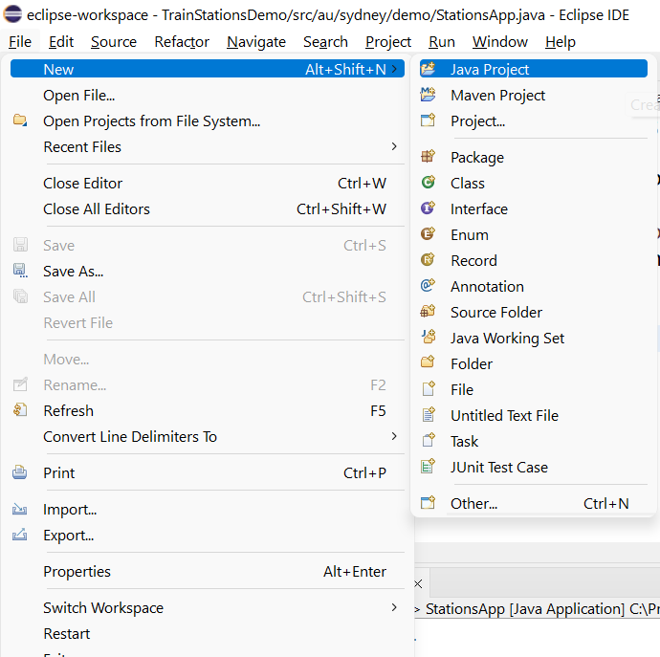
Input/Output (I/O) – Java Example in Eclipse
1) Create a project and class
Open Eclipse → File ▸ New ▸ Java Project → name it (e.g., IntroProgramming) → Finish. (If asked about module-info.java, choose Don’t Create.)

Slide 48
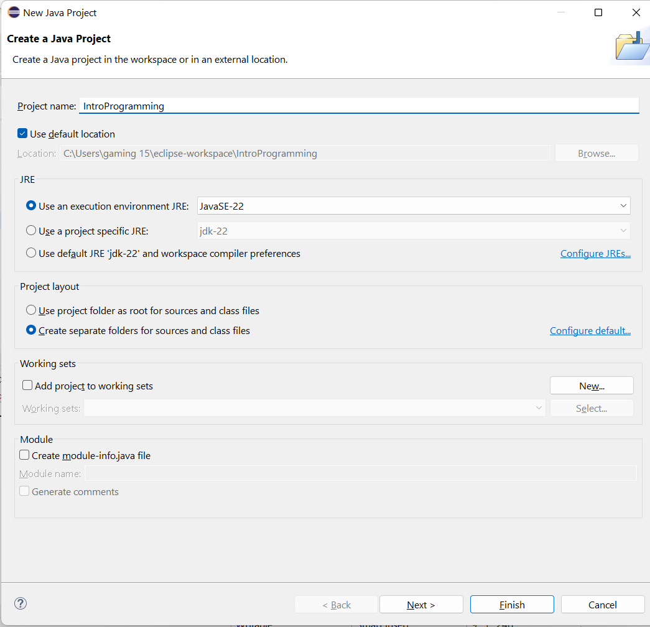
Input/Output (I/O) Input/Output (I/O) – Java Example in Eclipse
1) Create a project and class
Open Eclipse → File ▸ New ▸ Java Project → name it (e.g., IntroProgramming) → Finish. (If asked about module-info.java, choose Don’t Create.)

Slide 49
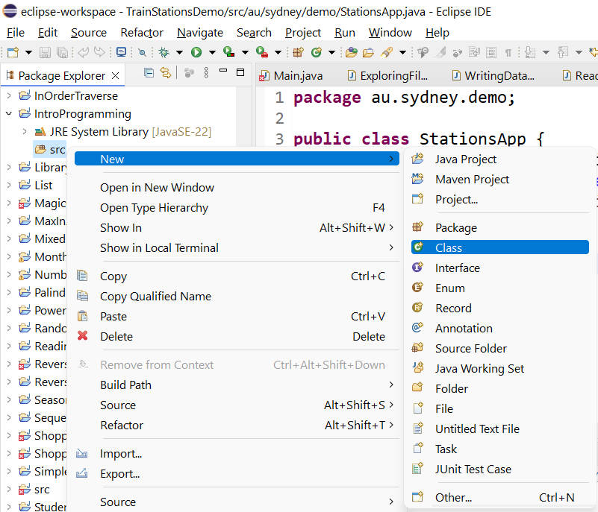
Input/Output (I/O) – Java Example in Eclipse
1) Create a project and class
Open Eclipse → File ▸ New ▸ Java Project → name it (e.g., IntroProgramming) → Finish. (If asked about module-info.java, choose Don’t Create.)

Slide 50
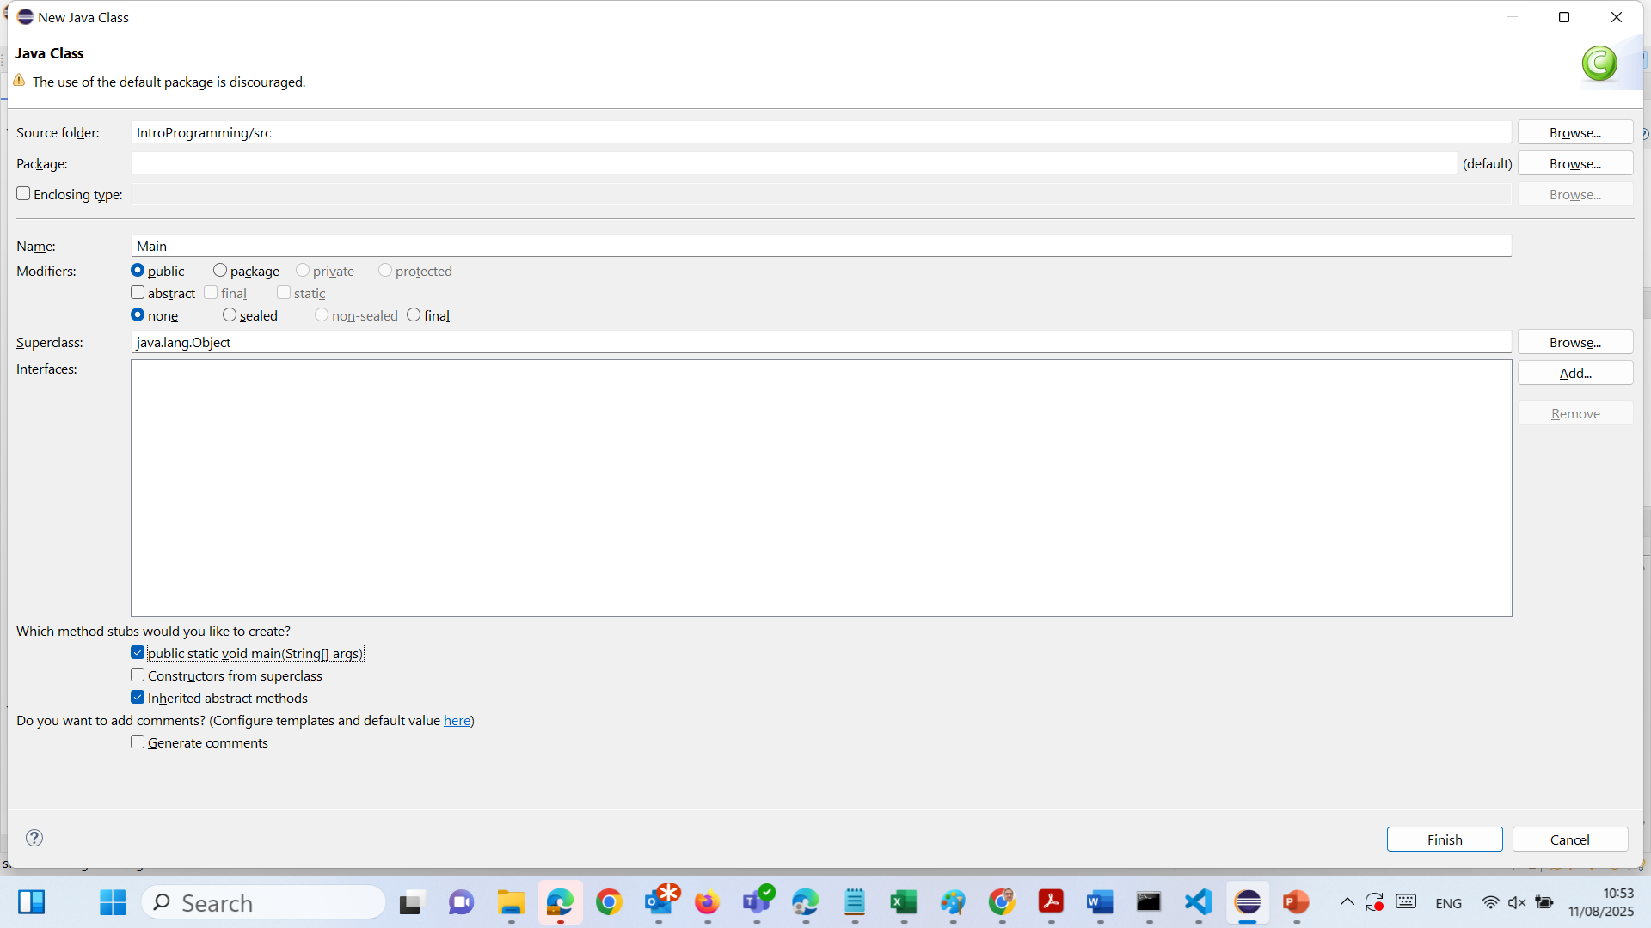
Input/Output (I/O) – Java Example in Eclipse
Right-click src → New ▸ Class → Name: Main → tick public static void main(String[] args) → Finish.

Slide 51
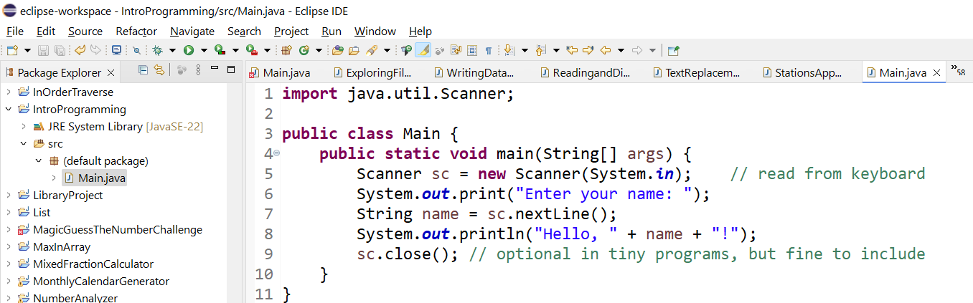
Input/Output (I/O) – Java Example in Eclipse
Right-click src → New ▸ Class → Name: Main → tick public static void main(String[] args) → Finish.

Slide 52
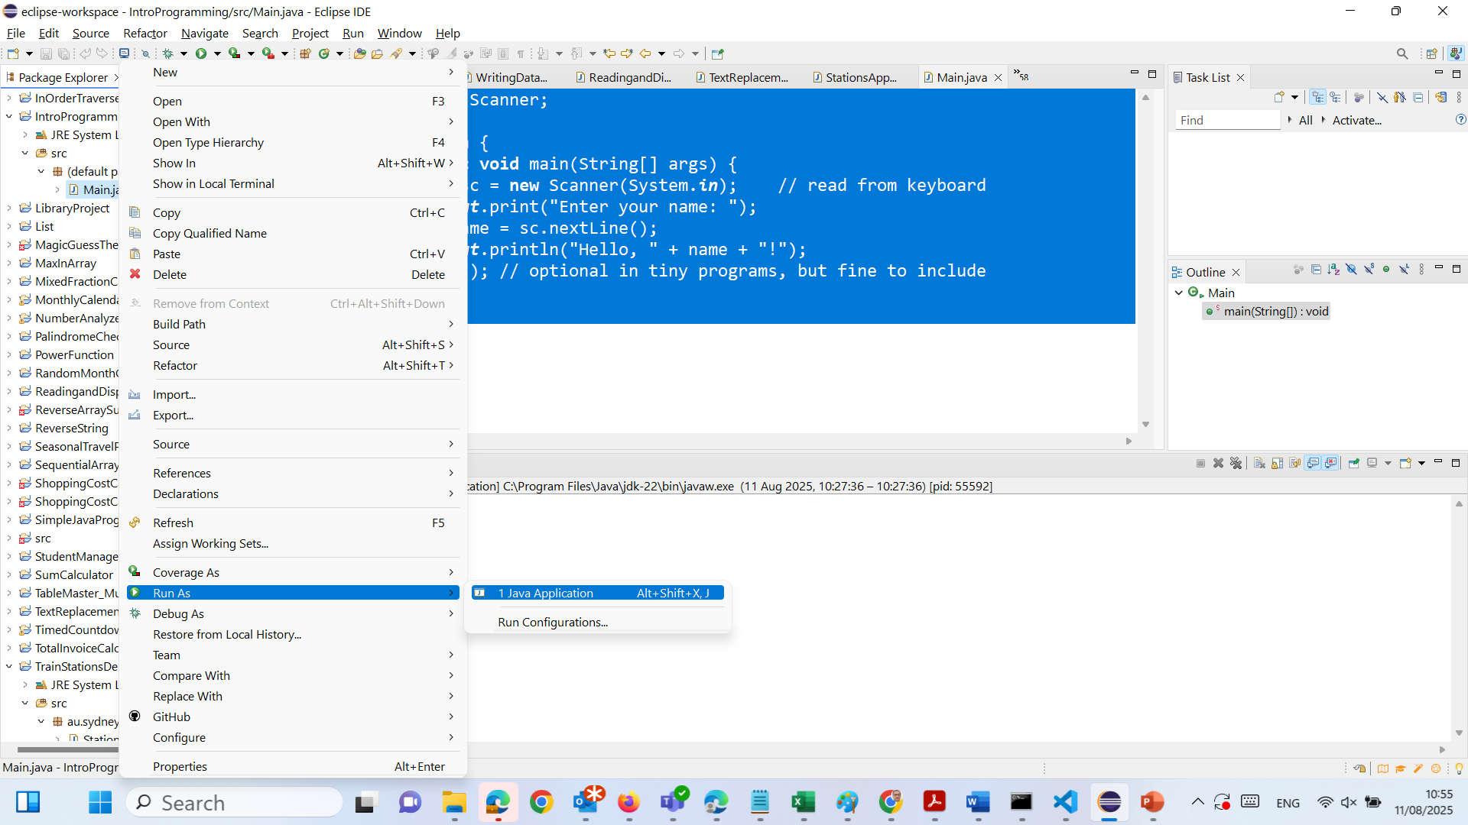
Input/Output (I/O) – Java Example in Eclipse
3. Run it

Slide 53
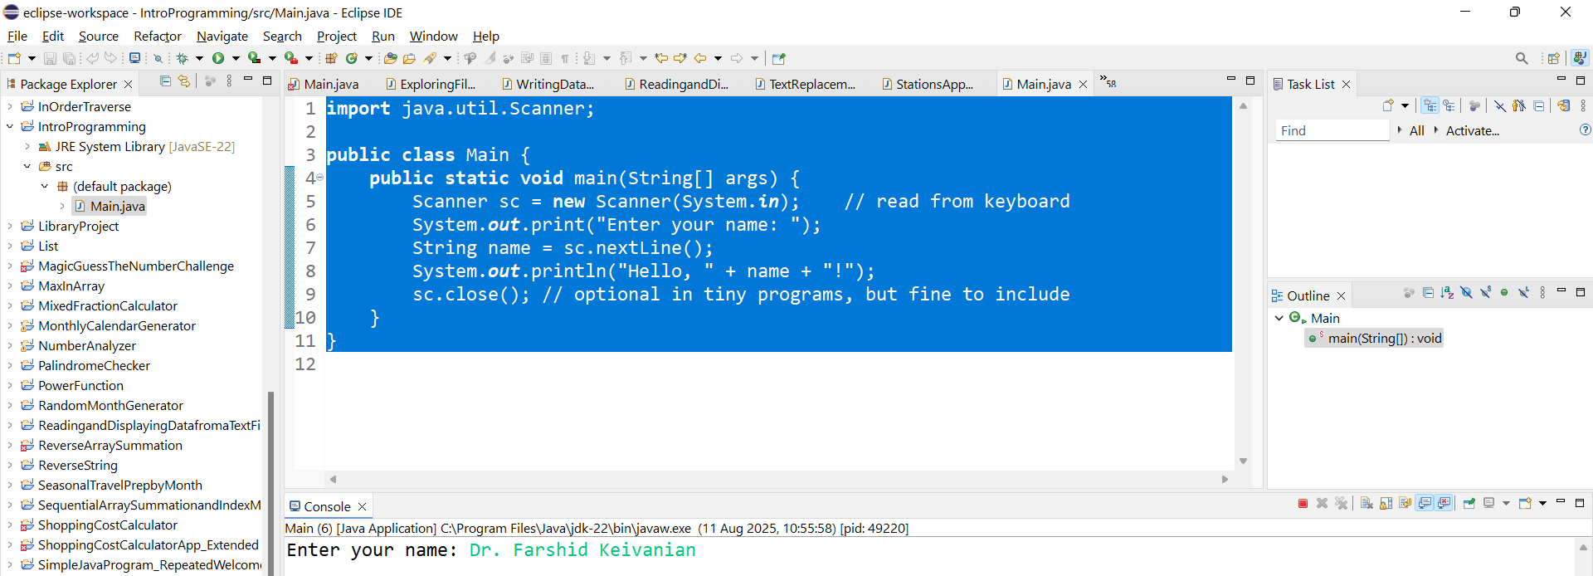
Input/Output (I/O) – Java Example in Eclipse
3. See the Results

Slide 54

Happy Learning and Bright Futures Ahead! Dr. Farshid Keivanian Stay Connected: linkedin.com/in/farshid-keivanian github.com/FarshidKeivanian
Education is the most powerful weapon you can use to change the world. — Nelson Mandela

